Slide 1
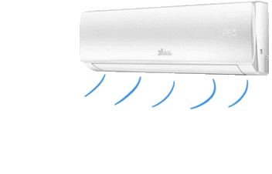

DESIGN A FUZZY LOGIC BASED EXPERT SYSTEM FOR AIR CONDITION

Slide 2

PROJECT DETAILS
Submitted by
Name - Rohit Kumar
Reg. No - 12104675
Section – K21MR
Roll No – RK21MRB45
School Of Computer Science And Engineering
Lovely Professional University
Phagwara, Punjab (India)
April, 2023

Slide 3

INTRODUCTION
Air conditioning systems are used to maintain a comfortable temperature and humidity level in indoor environments. Traditional air conditioning systems use a simple on-off controller to regulate the compressor speed. This type of controller can be inefficient and can lead to temperature fluctuations. Fuzzy logic is a type of artificial intelligence that can be used to control complex systems. Fuzzy logic controllers can make more nuanced decisions than traditional on-off controllers, which can lead to improved performance and efficiency. The main concept of Fuzzy Logic controller is to insert an operator’s expertise in its design to regulate the processes for describing the input -output co-relation is using the set of fuzzy control rules linking the linguistic variables such as IF-THEN

Slide 4
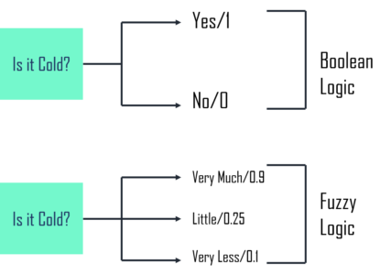
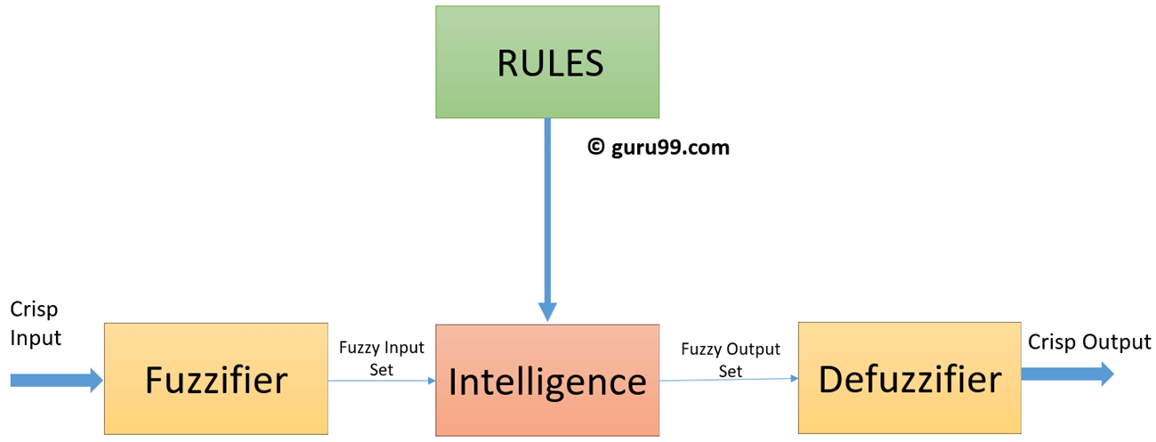
FUZZY LOGIC
Fuzzy logic is a way of thinking about computers that is a bit different from what we used. Instead of just saying something is true or false, fuzzy logic lets us express things in degrees of truth. Imagine a sliding scale where something can be a little bit true or mostly true but not entirely true. This idea comes from the fact that when people make decisions, Fuzzy logic tries to capture this more flexible and human-like way of thinking in computing.

Slide 5
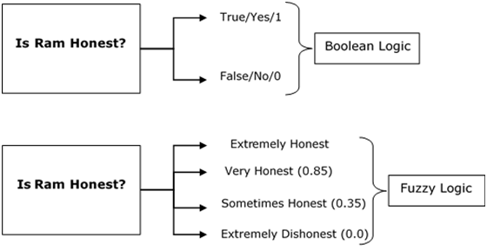

Slide 6

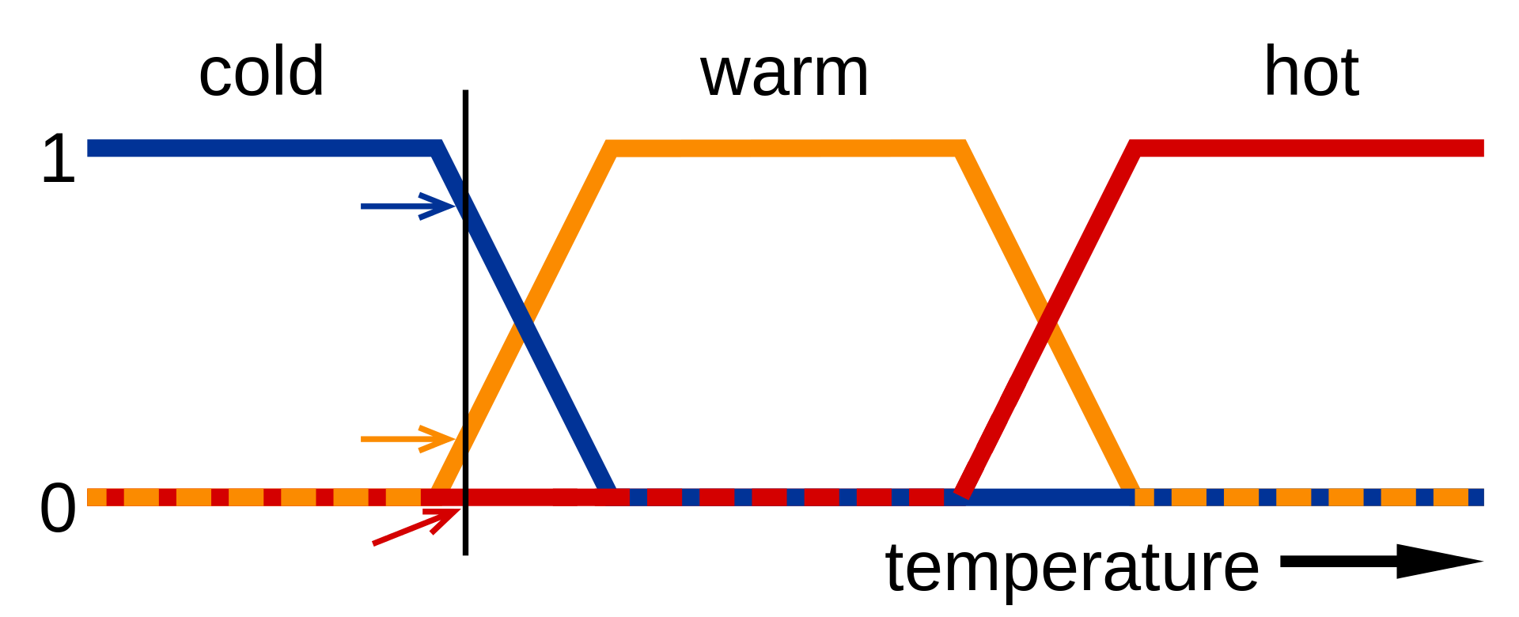
Use of Fuzzy Logic in Air Conditioning
Fuzzy logic is a mathematical concept that allows for handling uncertain information. In air conditioning, it provides a powerful tool for making decisions in varying and complex environments.
Fuzzy logic plays a vital role in improving energy efficiency. By dynamically adjusting the air conditioning operation based on current conditions.
Fuzzy logic enables air conditioning systems to work with a higher degree of precision by considering a wide range of input variables.
Air conditioning systems often face unpredictable and complex conditions, such as rapidly changing outdoor weather or varying indoor occupancy.

Slide 7
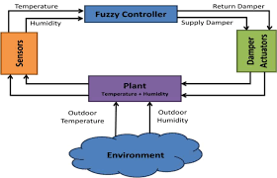
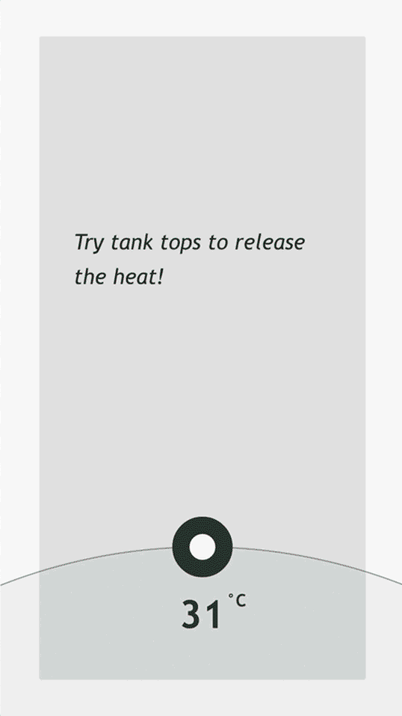
Components AND Data Collection
Before we delve into the specifics, it's essential to understand the fundamental components that make up the expert system for air conditioning.
Input Variables:
Temperature: Temperature is a crucial input variable as it directly influences the user's comfort and the system's energy consumption. Fuzzy logic allows the system to interpret temperature variations more flexibly than traditional control systems.
Humidity: Humidity levels play a significant role in the perceived comfort of an indoor environment. Fuzzy logic can adapt the air conditioning system's operation to maintain an ideal humidity level, ensuring a pleasant atmosphere.
User Preferences: Considering user preferences is a key feature of fuzzy logic-based systems. These preferences can include desired temperature ranges, fan speed, and even schedules.
Output:
Ideal Temperature: The primary goal of the system is to maintain an ideal temperature within the user-defined range, ensuring comfort and satisfaction. Fuzzy logic helps in determining this ideal temperature by considering the input variables and user preferences.
Fan Speed: The fan speed is another crucial output variable. Fuzzy logic decides the appropriate fan speed to distribute conditioned air effectively. It can adjust the fan speed to optimize comfort and energy efficiency.

Slide 8






Slide 9
FIS
The following five rules will help you to understand the construction of FIS
Rule base:- It contains If then rule or that contains different set of rules
Database rule – It defines the membership function of fuzzy set used in fuzzy rules
Decision making unit- It performs operation on rules
Fuzzification interface unit:- It converts the crisp quantities into the fuzzy quantities
Difuzzyfication :-

Slide 10
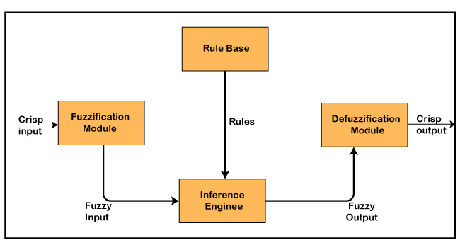

Slide 11
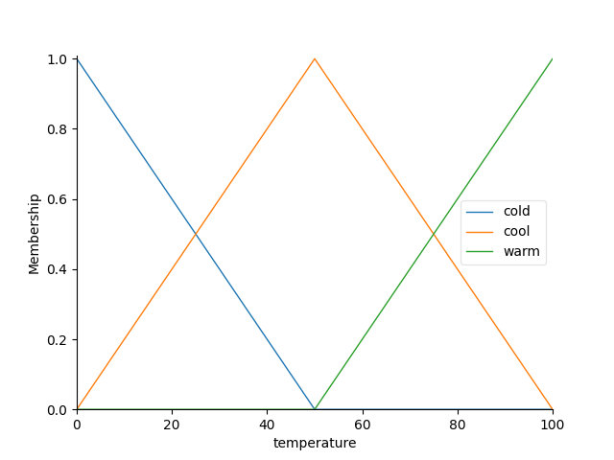
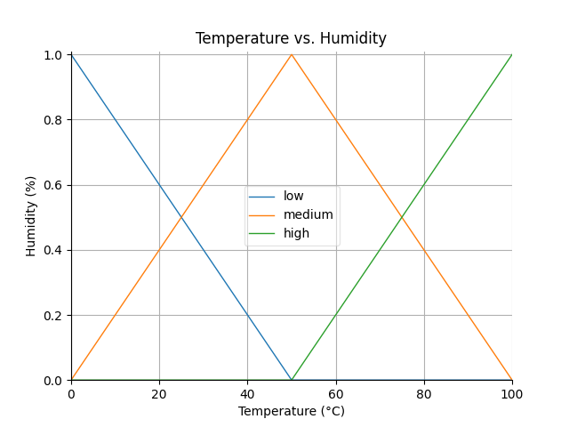
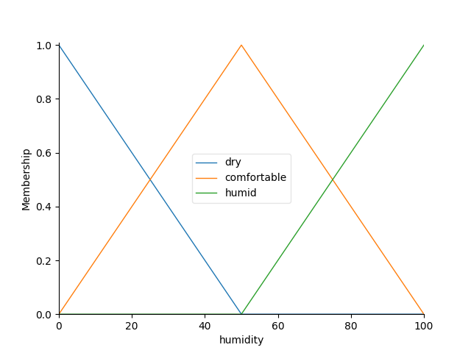
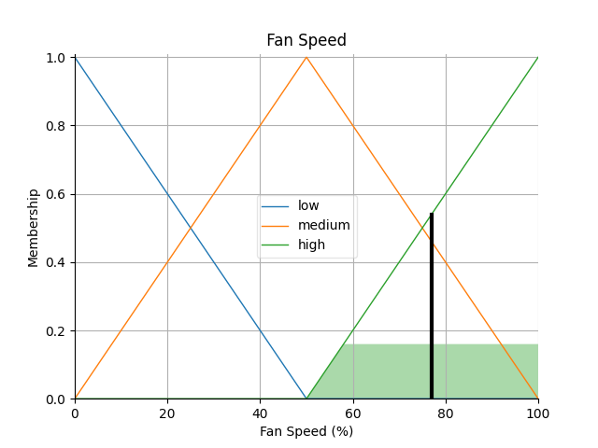

Slide 12
CHALLENGES
Modeling Complexity:
fuzzy logic model can be challenging Developing accurate fuzzy sets and rules to represent the relationships between input variables (temperature, humidity) and the desired output (fan speed) requires expertise.
Rule Base Design:
Constructing a comprehensive and effective set of fuzzy rules that accurately reflects the behavior of the air conditioning system can be complex. Determining the appropriate linguistic terms and membership functions for each variable is crucial for the system's performance.
Data Collection and Validation:
Acquiring real-world data to train and validate the fuzzy logic system is essential. Ensuring that the collected data is representative of diverse environmental conditions and user preferences is a challenge.
Adaptability to Changing Conditions:
Designing the system to adapt dynamically to varying environmental conditions, user preferences, and other factors is challenging. The system needs to be responsive to changes in temperature, humidity, and other relevant parameters.
Validation and Testing
Thoroughly validating and testing the fuzzy logic system under various scenarios and conditions is a complex task. It involves simulating a wide range of situations to ensure the system behaves as expected.

Slide 13


Future Developments
AI Integration:
Integrating machine learning can enhance the adaptability of fuzzy logic systems. They can learn from historical data to make even more informed decisions about temperature control, energy efficiency, and user preferences. By incorporating predictive analytics, systems can anticipate environmental changes and user behavior. This anticipatory approach can lead to further energy savings and increased comfort.
IoT Connectivity:
Fuzzy logic-based systems can take full advantage of the Internet of Things (IoT). This level of data granularity can result in even smarter decision - making. IoT connectivity allows users to control their air conditioning systems remotely through mobile apps or voice assistants, making the user experience more convenient and efficient.
Personalized Health and Well-being:
Future systems can incorporate biometric sensors to assess the physiological state of occupants, such as heart rate and body temperature. This information can be used to further personalize the indoor environment for well-being and health benefits.
Energy Sustainability:
Fuzzy logic systems can be designed to work in harmony with renewable energy sources. They can optimize cooling and heating operations when renewable energy is abundant, reducing reliance on non-renewable sources. Integrating with demand response programs can help utilities and users manage energy consumption efficiently during peak periods, reducing the strain on the grid.

Slide 14
CONCLUSION
In conclusion, I would like to say that the integration of fuzzy logic into air conditioning systems signifies a significant advancement in improving comfort, energy efficiency, and adaptability. The benefits of fuzzy logic include enhanced energy efficiency, greater user comfort through individualized control, and adaptability to changing conditions. Future developments in fuzzy logic-based air conditioning systems, including AI integration, IoT connectivity, energy sustainability, and personalized well-being, promise even greater improvements in user experience and sustainability. Fuzzy logic has the potential to revolutionize the way we interact with and manage air conditioning, making it not only more energy-efficient but also more tailored to individual needs and responsive to the evolving challenges of the modern world. It represents a path forward in creating healthier, more comfortable, and more sustainable indoor environments.

Slide 15


